Slide 1
Financial Modeling
Capital Budgeting and Valuation Models
Jacqueline Garner, Ph.D.
Lecturer
Scheller College of Business
Required Return for FCFF, FCFE and APV Model
Notes:
Hello, I’m Jacqueline Garner, and welcome to Financial Modeling

Slide 2
Before We Begin…

Slide 3
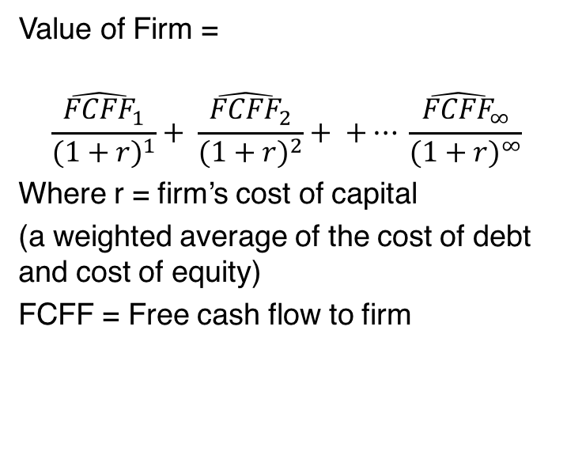
Free Cash Flow to the Firm Model
Value of Firm =
$$\frac{{\hat{FCFF}}_{1}}{{(1+r)}^{1}}+ \frac{{\hat{FCFF}}_{2}}{{(1+r)}^{2}}+ +… \frac{{\hat{FCFF}}_{∞}}{{(1+r)}^{∞}}$$
Where r = firm’s cost of capital
(a weighted average of the cost of debt and cost of equity)
FCFF = Free cash flow to firm

Slide 4
Required Return for Assets
Assets | Liabilities + Equity
Net current assets | Debt
Fixed assets | Equity

Slide 5
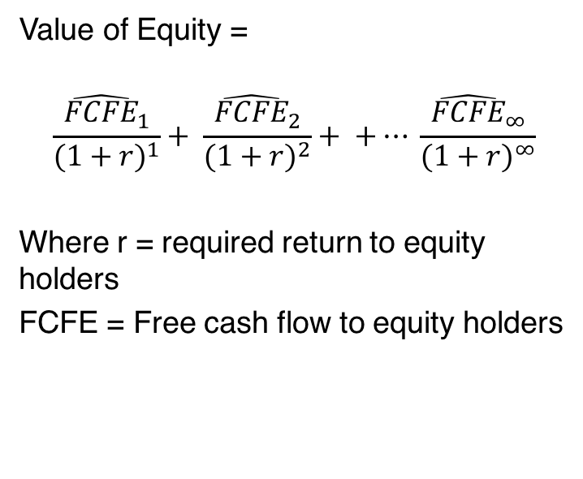
Free Cash Flow to Equity Holders Model
Value of Equity =
$$\frac{{\hat{FCFE}}_{1}}{{(1+r)}^{1}}+ \frac{{\hat{FCFE}}_{2}}{{(1+r)}^{2}}+ +… \frac{{\hat{FCFE}}_{∞}}{{(1+r)}^{∞}}$$
Where r = required return to equity holders
FCFE = Free cash flow to equity holders

Slide 6
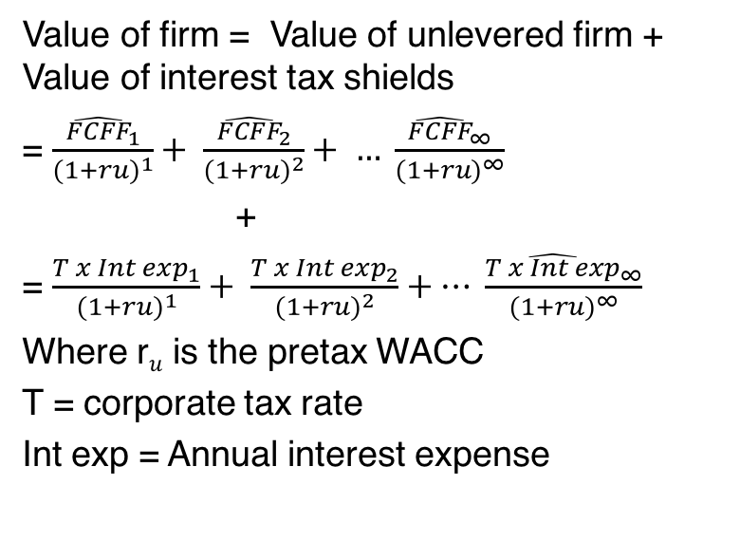
Adjusted Present Value (APV)
Value of firm = Value of unlevered firm + Value of interest tax shields
= $\frac{{\hat{FCFF}}_{1}}{{(1+ru)}^{1}}+ \frac{{\hat{FCFF}}_{2}}{{(1+ru)}^{2}}+ … \frac{{\hat{FCFF}}_{∞}}{{(1+ru)}^{∞}}$
+
= $\frac{{T x Int exp}_{1}}{{(1+ru)}^{1}}+ \frac{{T x Int exp}_{2}}{{(1+ru)}^{2}}+… \frac{{\hat{T x Int exp}}_{∞}}{{(1+ru)}^{∞}}$
Where r$u$ is the pretax WACC
T = corporate tax rate
Int exp = Annual interest expense

Slide 7
Summary

